Slide 1

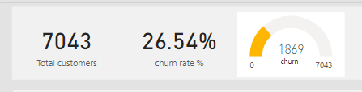

Customer Retention Analysis
Prepare By Omar Faruk
date :
3/21/2023

Slide 2
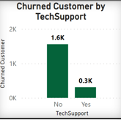
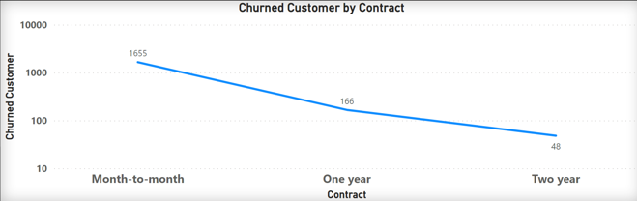
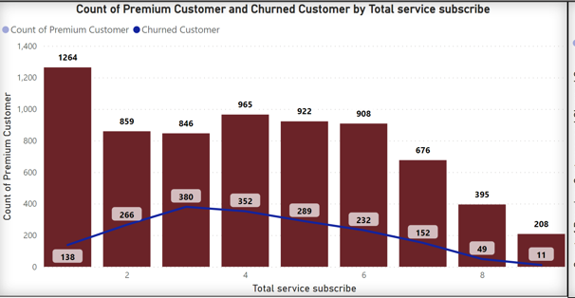
Key Performance Indicators
1) Increase tech support capacity for Fiber Optic customers and lower tech tickets per customer to 0.5
2) Increase sale of One year and Two year contracts by 5% each
3) Increase No. of Service to the Churned customer at lower charge.

